Slide 1
Open Source Platform and Network Administration
Lesson 16

Slide 3
Learning Objective
Describe Linux file-sharing and remote access solutions.

Slide 4
Key Concepts
File-sharing with Network File System (NFS) and Samba
Secure remote access tools
Encryption with Secure Shell (SSH) and the Internet Protocol Security (IPsec) protocol

Slide 5
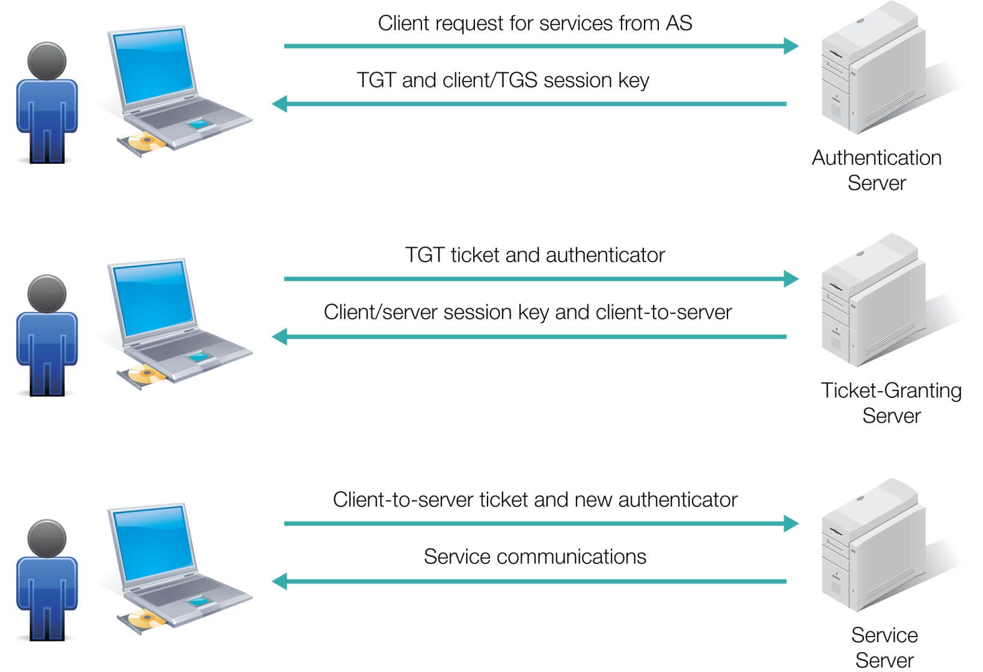
Kerberos
Notes:
SSH client commands: ssh, scp, and sftp
Authentication:
Username/password
Passphrase with public/private keys
One-time passwords
Kerberos

Slide 6
Authentication
Username/password
Passphrase with public/private keys
One-time passwords
Kerberos
Notes:
SSH client commands: ssh, scp, and sftp
Authentication:
Username/password
Passphrase with public/private keys
One-time passwords
Kerberos

Slide 7
Keeping vsFTP Secure
Standard vsFTP configuration file is vsftpd.conf
Regulate or isolate directories where vsFTP stores files for anonymous uploads and downloads
Safer to run vsFTP as its own service, with its own control script in the /etc/init.d/ directory
Option for uploads is to change the ownership of such files to a specific user, such as nobody or another user configured with minimal privileges

Slide 8
Common Network Services Software
File Sharing
Samba | Network File System (NFS)
Has built-in interoperability with Windows clients | Generally faster than Samba when transferring large files
Can be set up as a member server in Windows environment | Easy to set up
Has username/password authentication | Authentication is Internet Protocol (IP)-based; however, it can support Kerberos
 | Can configure to squash root

Slide 9
Common Network Services Software (Continued)
Web server
Database
Authentication and directory services
E-mail and printing
File Transfer Protocol (FTP)

Slide 10
Configuring Samba
Install Samba service
Create Samba user accounts
Edit main Samba configuration file: smb.conf

Slide 11
Configuring Samba (Continued)
Network-related options
Logging options
Standalone server options
Domain members and domain controller options
Browser control, name resolution, printing options

Slide 12
Secure Shell (SSH)
Open Berkeley Software Distribution (BSD) Secure Shell (OpenSSH)
SSH client commands
Port 22
Authentication
X11 forwarding
Port forwarding
Notes:
SSH client commands: ssh, scp, and sftp

Slide 13
Make Sure SSH Stays Secure
Modify default SSH server configuration file to promote security
Use SSH to configure interactive username/password connections
Automate the SSH connection process through the use of public/private key pairs
Passphrases are more secure than passwords
Use private/public key pairs with large number of bits, typically 1,024 and above

